Slide 1
Analytics Project Presentation - Summer 2015
Analytics Project:
Recommender Systems for NYC Residential Community
Team:
Zeleng Zhuang , Yanhong Yang, Nicholas Souris
Abstract:
Recommend communities suitable for a specific person based on personal preferences
Scrape data from various sources and use hadoop technology to cleanse and filter them
Build a website as a front-end to our system

Slide 2
Recommender Systems for NYC
Motivation
Who are the users of this analytic?
People who are looking to buy or rent an apartment in the wider New York city area.
Who will benefit from this analytic?
Prospective renters
Prospective buyers
Landlords
Sellers
Why is this analytic important?
It turns apartment hunting into a much less daunting task with the aid of an algorithm which automatically finds an area that is aligned to the users personal preferences.

Slide 3
Recommender Systems for NYC
Data Sources
Name: www.city-data.com
Description:
Several types of information indexed by zip code of the wider New York city area, such as race, religion, average income etc..
Name: yelp.com
Description:
Two different sets of data were scraped. One set involved information on clinics and kinder gardens and the other one had to do with restaurants and businesses in general.
Name: bestplaces.net
Description:
Scraped data on crime rates for each zip code in New York city.

Slide 4
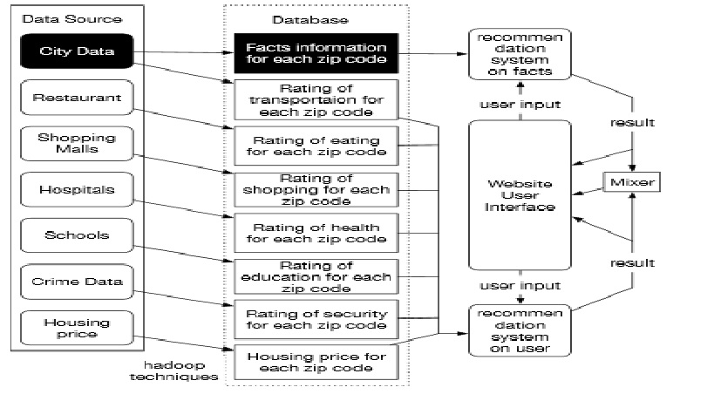
Recommender Systems for NYC

Slide 5
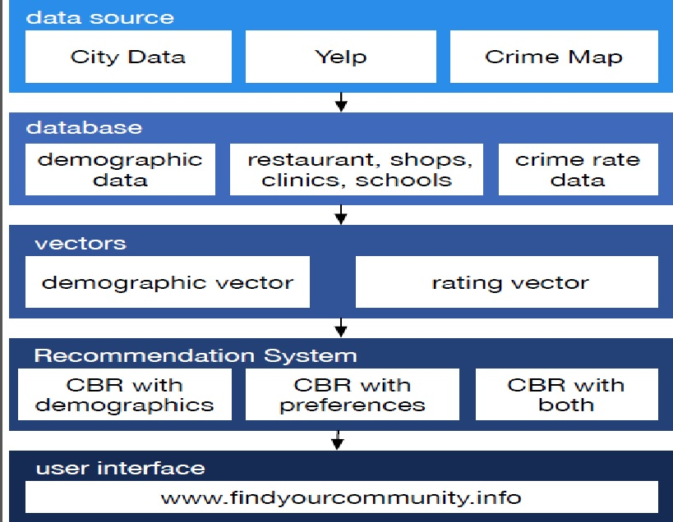
Recommender Systems for NYC

Slide 6
Recommender Systems for NYC
Platform(s) on which the analytic ran:
Map-Reduce
Pig
Hive
Spark.

Slide 7
Recommender Systems for NYC
Results
1. <Result 1>
<Tell us up to three results , observations, or outcomes.>
2. <Result 2>
3. <Result 3>

Slide 8
Recommender Systems for NYC
Obstacles
1. Trying to authenticate the validity of the recommendations of the system.
2. Not enough time to implement more features (specific apartment recommendations, make recommendations on other cities as well)

Slide 9
Recommender Systems for NYC
Summary
Scraped data that had to do with New York city population and businesses.
Built a program that uses a vector based formula to recommend suitable areas to live in based on a users preferences.
Acknowledgements
Amazon Web Services
Cloudera

Slide 10
Recommender Systems for NYC
References
G. ADOMAVICIUS AND A.TUZHILIN.
Toward the Next Generation of Recommender Systems: A Survey of the State-of-the-Art and Possible Extensions.
IEEE Trans. Knowl. Data Eng. 17, 6 (June 2005)
2. R. BAEZA-YATES AND B. RIBEIRO-NETO.
Modern information Retrieval.
Addison-Wesley, 1999
3. J.S. BREESE, D. HECKERMAN AND C.KADIE.
Empirical Analysis of Predictive Algorithms for Collaborative Filtering.
In Proc. 14th Conf. Uncertainty in Artificial Intelligence, July 1998.
4. M. J. PAZZANI AND D. BILLSUS.
Content-based recommendation systems. IN P. Brusilovsky, A. Kobsa, and W. Nejdl (Eds.):
The adaptive web,
LNCS. 4321, pp. 325–341, 2007.

Slide 11
Recommender Systems for NYC
References
5. P. RESNICK, N. IAKOVOU, M. SUSHAK, P. BERGSTROM,AND J. RIEDL.
GroupLens: An Open Architecture for Collaborative Filtering of Netnews.
In Proc. Computer Supported Cooperative Work
Conf., 1994.
6. G. SALTON.
Automatic Text Processing.
Addison-Wesley, 1989.
7. U. SHARDANAND AND P. MAES.
Social Information Filtering:
Algorithms for Automating “Word of Mouth”.
In Proc. Conf. Human Factors in Computing Systems, 1995.
8. T. WHITE.
Hadoop: The Definitive Guide.
O'Reilly Media Inc.,
Sebastopol, CA, May 2012

